Slide 1

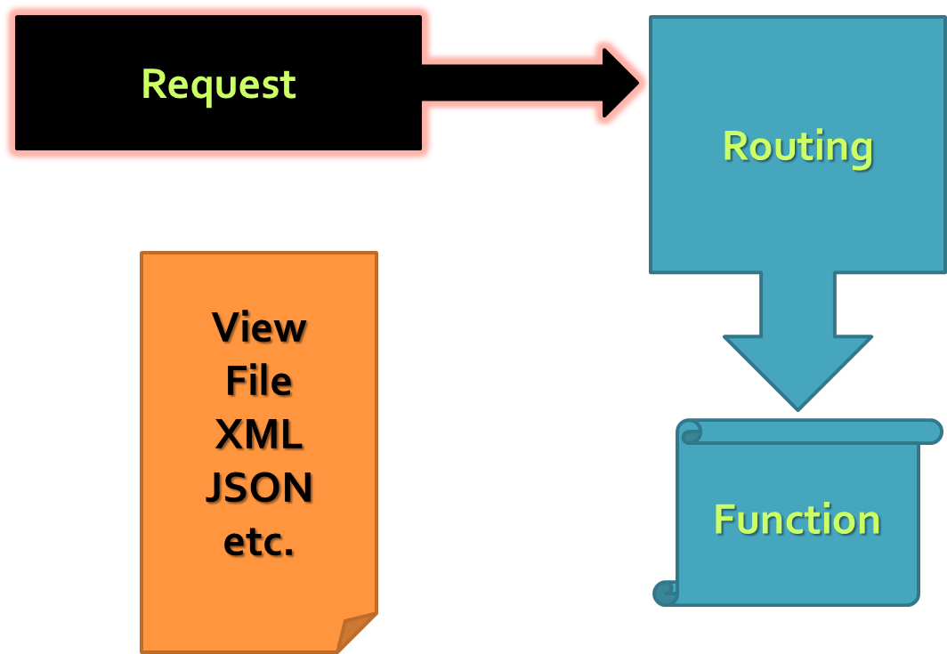
ExpressJS
Web development with ExpressJS
Telerik Software Academy
Learning & Development
http://academy.telerik.com

Slide 2

Table of Contents
Middleware
ExpressJS
Views and layout
Working with Data
Common and Advanced Scenarios

Slide 3
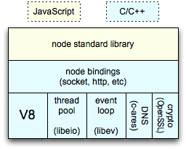
node.js
Event-Driven, Asynchronous IO, Server-Side JavaScript library in C
Open Source
Available on
Windows
Service
Under IIS (iisnode)
*nix systems
As a service
Azure
Heroku

Slide 4
NodeJS Web Server
Basic server implementation
var http = require('http');
http.createServer(function(req, res) {
res.writeHead(200, {
'Content-Type': 'text/plain'
}); //return success header
res.write('My server is running! ^_^'); //response
res.end(); //finish processing current request
}).listen(1234);

Slide 5
Middleware for NodeJS
Connect is a middleware framework for node
Built on top of node’s Http Server
http://www.senchalabs.org/connect/
$ npm install connect
var connect = require('connect');
var app = connect()
.use(connect.logger('dev'))
.use(connect.static('public'))
.use(function(req, res){
res.end('hello world\n');
})
http.createServer(app).listen(3000);

Slide 6
Connect Middleware
Request Processing Pipeline
Request
Response
Middleware (logging, authentication, etc.)

Slide 7
Connect for NodeJS – Example
Custom middleware function for connect
var connect = require('connect'),
util = require('util');
var interceptorFunction = function(request, response, next) {
console.log(util.format('Request for %s with method %s', request.url, request.method));
next();
};
var app = connect()
// .use('/log', interceptorFunction)
.use(interceptorFunction)
.use(function onRequest(request, response) {
response.end('Hello from Connect!');
}).listen(3001);

Slide 8
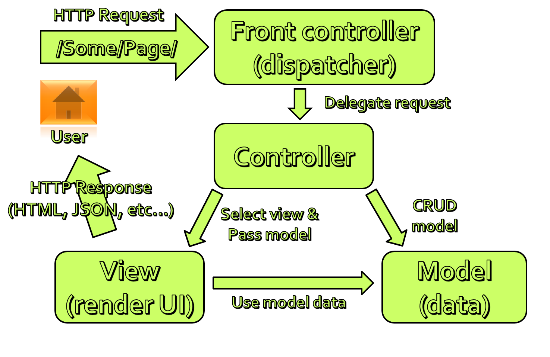
Express.js 4.0
Has middleware built-in
Adds functionality to the normal server
Request / Response enhancements
Routing
View Support
HTML Helpers
Content Negotiation

Slide 9
Basic Architecture
Request
Routing
View
File
XML
JSON etc.
Function

Slide 10
First Express App
var express = require('express');
var app = express();
app.get('/', function (request, response) {
response.send('Welcome to Express!');
});
app.get('/customer/:id', function (req, res) { res.send('Customer requested is ' + req.params['id']);
});
app.listen(3000);

Slide 11
Demo: Creating Express Applications
Simple ExpressJS application and "nodemon"
Create routes and require() them
Pass parameters
Configure middleware

Slide 12
Views in ExpressJS
User Interface
Based on Templates
Support for multiple View Engines
Jade, EJS, JSHtml, . . .
Default is Jade
http://jade-lang.com
app.get('/', function (req, res) {
res.render('index');
});

Slide 13
Views in ExpressJS – Example
var express = require('express'),
path = require('path');
var app = express();
app.configure(function () {
app.set('views', __dirname + '/views');
app.set('view engine', 'jade');
app.use(express.static(path.join(__dirname, 'public')));
});
app.get('/', function (req, res) {
res.render('empty');
});
app.listen(3000);
doctype
html(lang="en")
head
title Welcome to this emtpy page
body

Slide 14

Demo: Views in ExpressJS
Show simple views in ExpressJS
Jade syntax examples
Layouts and blocks
Stylus

Slide 15
Working with Data
Pass data to the views
Read data from the views (bodyParser)
Read and send files
Data for all views
res.render('index', { title: 'Customer List' });
res.render('index', { title: 'Customer List' });
var filePath = req.files.picture.path;
// ...
res.download(filePath);
res.sendfile(filePath);
app.locals.clock = { datetime: new Date().toUTCString()};

Slide 16

Demo: Working with data
Pass data to views (customer.index)
Submit data from views (customer.create)
Content negotiation (customer.details)
Upload files (customer.create)
Helpers (app.locals)

Slide 17

Demo: Advanced Scenarios
Cookies
Sessions
Custom middleware
Authentication and authorization

Slide 18
Next Steps
Express.js Samples
https://github.com/visionmedia/express
Database Support
MS SQL
CouchDB
PostgreSQL
Redis
Socket.io
Real-time support

Slide 19
Next Steps (2)
Search on npm.org before you re-invent the wheel
Express is Lightweight Framework and Fast to work with
Testing is not optional
Mocha
JavaScript can get messy

Slide 20
ExpressJS
http://academy.telerik.com

Slide 21
Homework
Create a web site (with normal design) using Express with private and public parts – CRUD operations over a model by your choice
At least 6 pages
Use Express
Use File upload
Use Jade
Use Stylus
Use Passport module for authentication
Use good application architecture

